Slide 1
AngularJS

Slide 2
Introduction
AngularJS is a JavaScript framework for dynamic web application.
It is a powerful library of JavaScript and It can be added to an HTML page with a <script> tag.
AngularJS, is an open-source web application framework which is maintained by Google and a community of individual developers.
It can be freely used, changed and shared by anyone.
It is an excellent framework for building single page applications (SPA).
Notes:
A framework, or software framework, is a platform for developing software applications.
For example, a framework may include predefined classes and functions that can be used to process input,
manage hardware devices, and interact with system software.
A framework may also include code libraries, a compiler, and other programs used in the software development process.

Slide 3
Why called AngularJS
Because HTML has Angular brackets and "ng" sounds like "Angular".

Slide 4
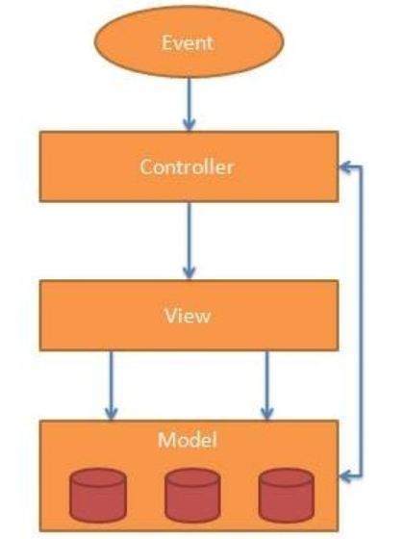
AngularJS MVC Architecture
MVC stands for Model View Controller.
It is a software design pattern for developing web applications.
It is very popular because it isolates the application logic from the user interface layer and supports separation of concerns.

Slide 5
Description
Model: It is responsible for managing application data. It responds to the requests from view and to the instructions from controller to update itself.
View: It is responsible for displaying all data or only a portion of data to the users. It also specifies the data in a particular format triggered by the controller's decision to present the data.
Controller: It is responsible to control the relation between models and views. It responds to user input and performs interactions on the data model objects. The controller receives input, validates it, and then performs business operations that modify the state of the data model.

Slide 6
Angularjs Directives
It improve the feature or functionality of html elements.
Directives are markers on a DOM element which attach a special behavior to it.
For example, static Html does not know how to create and display a date picker widget.
To teach Html this new syntax we need a directive.
AngularJS directives are extended Html attributes with the prefix ng-.

Slide 7
Continue
The AngularJS framework can be divided into three major parts;
ng-app : The ng-app directive initializes an AngularJS application.
ng-model : ng-model directive binds the value of HTML controls (input, select, textarea) to application data.
ng-bind : ng-bind directive binds the AngularJS application data to HTML tags.

Slide 8
ng-app
The ng-app directive initializes an AngularJS application.
Using this directive you can tell which part of html contains Angularjs app.
The ng-app directive also tells AngularJS that the <div> element is the "owner" of the AngularJS application.
Below we use ng-app with <div> tag.
<div ng-app="">
Enter text <input type="text" ng-model="name">
<p ng-bind="name"></p>
</div>
You can use data-ng-, instead of ng-, if you want to make your page HTML valid.

Slide 9
ng-model
The ng-model directive binds the value of Html controls (input, select, textarea) to application data.
The ng-model directive defines the model/variable to be used in AngularJS Application.
In the following example, we define a model named name.
<div data-ng-app="">
1st number <input type="number" ng-model="num1">
2nd number <input type="number" ng-model="num2"> <p><b>Sum:</b> {{num1 + num2}}</p>
</div>

Slide 10
ng-init
The ng-init directive initialize application data same like variable initialization in C language, In c language you initialize int a=10;.
The ng-init directive initializes an AngularJS Application data.
It is used to assign values to the variables.
<div ng-app="" ng-init="name='Porter'"> // initialize name="Porter" Name: <input type="text" ng-model="name"> <p>name: {{ name }}</p>

Slide 11
ng-bind
The AngularJS ng-bind directive replaces the content of an HTML element with the value of a given variable, or expression.
Data binding in AngularJS is the synchronization between the model and the view.
If you change the value of the given variable or expression, AngularJS changes the content of the specified HTML element as well as.
<div ng-app="">
Enter text <input type="text" ng-model="name">
<p ng-bind="name"></p>
</div>

Slide 12
ng-model directive
The ng-model directive binds the value of HTML controls (input, select, textarea) to application data.
The ng-model directive can also:
Provide type validation for application data (number, email, required).
Provide status for application data (invalid, dirty, touched, error).
Provide CSS classes for HTML elements.
Bind HTML elements to HTML forms.

Slide 13
Application Status
The ng-model directive can provide status for application data (valid, dirty, touched)
Valid: if true, the value meets all criteria
Dirty: if true, the value has been changed
Touched: if true, the field has been in focus

Slide 14
Validate User Input
The ng-model directive can provide type validation for application data (number, e-mail, required)

Slide 15
CSS Classes
The ng-model directive provides CSS classes for HTML elements, depending on their status.
The ng-model directive adds/removes the following classes, according to the status of the form field.
ng-empty
ng-not-empty
ng-touched
ng-untouched
ng-valid
ng-invalid
ng-dirty
ng-pristine
Notes:
The ng-dirty class tells you that the form has been modified by the user, whereas
the ng-pristineclass tells you that the form has not been modified by the user.

Slide 16
ng-repeat
The ng-repeat directive repeats an Html element.
ng-repeat directive repeats a specific element.
<div data-ng-app="" data-ng-init="num=[1, 2, 3]">
<p data-ng-repeat="x in num">
{{ x }}
</p>
</div>

Slide 17
AngularJS Expressions
AngularJS expressions can be written inside double braces: {{ expression }}.
AngularJS expressions can also be written inside a directive: ng-bind="expression".
AngularJS will resolve the expression, and return the result exactly where the expression is written.
AngularJS expressions are much like JavaScript expressions: They can contain literals, operators, and variables.
Example {{ 5 + 5 }} or {{ firstName + " " + lastName }}

Slide 18
AngularJS expression is like JavaScript code expression except for the following differences:
AngularJS expression cannot contain conditions, loops, exceptions or regular expressions e.g. if-else, ternary, for loop, while loop etc.
AngularJS expression cannot declare functions.
AngularJS expression cannot contain comma or void.
AngularJS expression cannot contain return keyword.

Slide 19
Examples
AngularJS expression contains literals of any data type.
AngularJS expression can contain arithmetic operators which will produce the result based on the type of operands, similar to JavaScript:
AngularJS expression can contain variables declared via ng-init directive. The ng-init directive is used to declare AngularJS application variables of any data type.

Slide 20
Continue
AngularJS Numbers
AngularJS Strings
AngularJS Objects
AngularJS Arrays

Slide 21
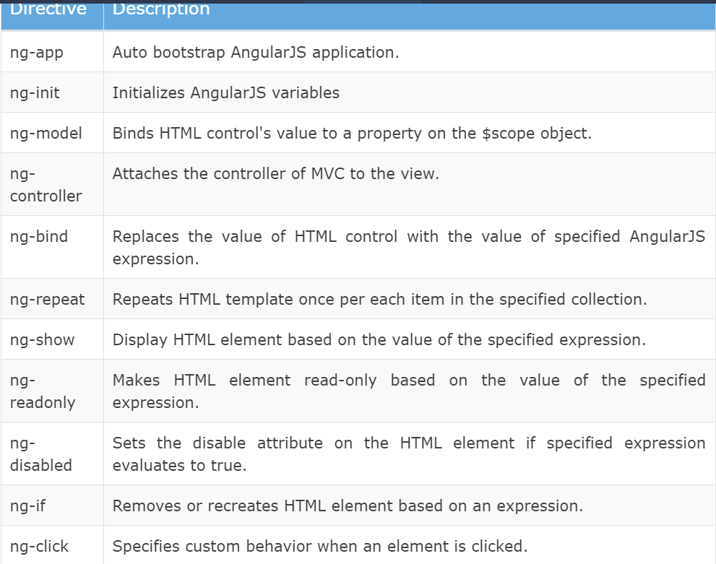

Slide 22
ng-if
The ng-if directive creates or removes an HTML element based on the Boolean value returned from the specified expression.
If an expression returns true then it recreates an element otherwise removes an element from the HTML document.

Slide 23
ng-readonly
The ng-readonly directive makes an HTML element read-only, based on the Boolean value returned from the specified expression.
If an expression returns true then the element will become read-only, otherwise not.

Slide 24
ng-disabled
The ng-disabled directive disables an HTML element, based on the Boolean value returned from the specified expression.
If an expression returns true the element will be disabled, otherwise not.

Slide 25
Directive Syntax
AngularJS directives can be applied to DOM elements in many ways.
It is not mandatory to use ng- syntax only.
Directive can start with x- or data-, for example ng-model directive can be written as data-ng-model or x-ng-model.
Also, the - in the directive can be replaced with : or _ or both.
For example, ng-model can be written as ng_model or ng:model.
It can also be a mix with data- or x-.

Slide 26
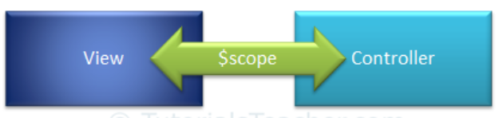
AngularJS Scope
The $scope in an AngularJS is a built-in object, which contains application data and methods.
You can create properties to a $scope object inside a controller function and assign a value or function to it.
The $scope is glue between a controller and view (HTML).
It transfers data from the controller to view and vice-versa.
The scope is the binding part between the HTML (view) and the JavaScript (controller).

Slide 27
Continue
The view can display $scope data using an expression, ng-model, or ng-bind directive.
AngularJS creates and injects a different $scope object to each controller in an application.
So, the data and methods attached to $scope inside one controller cannot be accessed in another controller.
With the nested controller, child controller will inherit the parent controller's scope object.
Therefore, child controller can access properties added in parent controller but parent controller cannot access properties added in child controller.

Slide 28
Note:
The ng-model directive is used for two-way data binding.
It transfers the data from controller to view and vice-versa.
An expression and ng-bind directive transfers data from controller to view but not vice-versa.

Slide 29
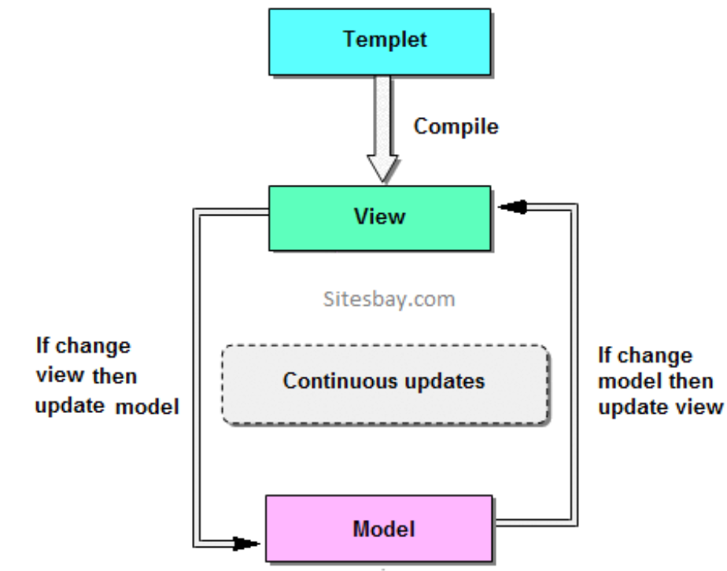
Two-Way Binding
The binding goes both ways.
If the user changes the value inside the input field, the AngularJS property will also change its value.

Slide 30
Understanding the Scope
If we consider an AngularJS application to consist of:
View, which is the HTML.
Model, which is the data available for the current view.
Controller, which is the JavaScript function that makes/changes/removes/controls the data.
Then the scope is the Model.
The scope is a JavaScript object with properties and methods, which are available for both the view and the controller.

Slide 31
$rootScope
An AngularJS application has a single $rootScope.
All the other $scope objects are child objects.
The properties and methods attached to $rootScope will be available to all the controllers.
The $scope object contains various methods.

Slide 32
Root Scope
All applications have a $rootScope which is the scope created on the HTML element that contains the ng-app directive.
The rootScope is available in the entire application.
If a variable has the same name in both the current scope and in the rootScope, the application uses the one in the current scope.
The following table lists important methods of $scope object.

Slide 33
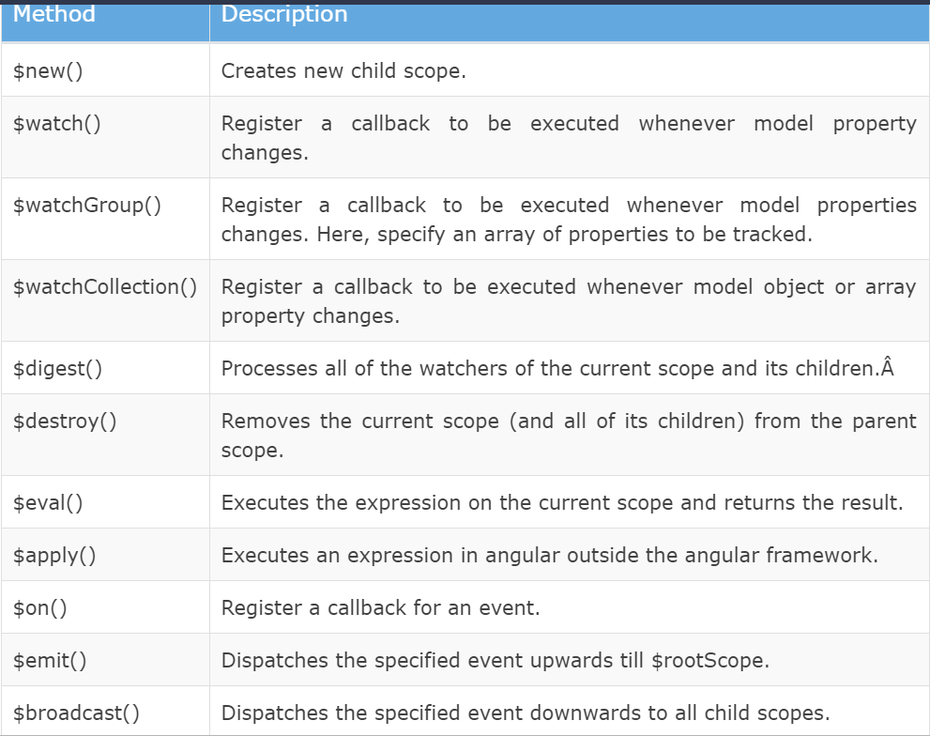

Slide 34
$watch
Angular scope object includes $watch event which will be raised whenever a model property is changed.
$watch registers a callback, which will get called whenever the specified model property "message" changes.

Slide 35
Angularjs Controller
AngularJS applications are controlled by Controller.
AngularJS controllers are used for control the data of AngularJS applications.
AngularJS controllers are regular JavaScript Objects.
For define controller in AngularJS application we need ng-controller directive names.
Notes:
In AngularJS, a Controller is defined by a JavaScript constructor function that is used to augment the AngularJS Scope.
Controllers can be attached to the DOM in different ways. For each of them, AngularJS will instantiate a new Controller object, using the specified Controller's constructor function:
the ngController directive. A new child scope will be created and made available as an injectable parameter to the Controller's constructor function as $scope.

Slide 36
AngularJS Controller
The controller in AngularJS is a JavaScript function that maintains the application data and behavior using $scope object.
You can attach properties and methods to the $scope object inside a controller function, which in turn will add/update the data and attach behaviours to HTML elements.
The ng-controller directive is used to specify a controller in HTML element, which will add behavior or maintain the data in that HTML element and its child elements.

Slide 37
Controller Example
Example demonstrates attaching properties to the $scope object inside a controller and then displaying property value in HTML.
Now, to create "myController", we need to create an application module.
After creating a module, we add a controller function using the controller() method where the first parameter should be the name of the controller and second parameter should be a function for the controller.
The controller function includes $scope parameter which will be injected by AngularJS framework.

Slide 38
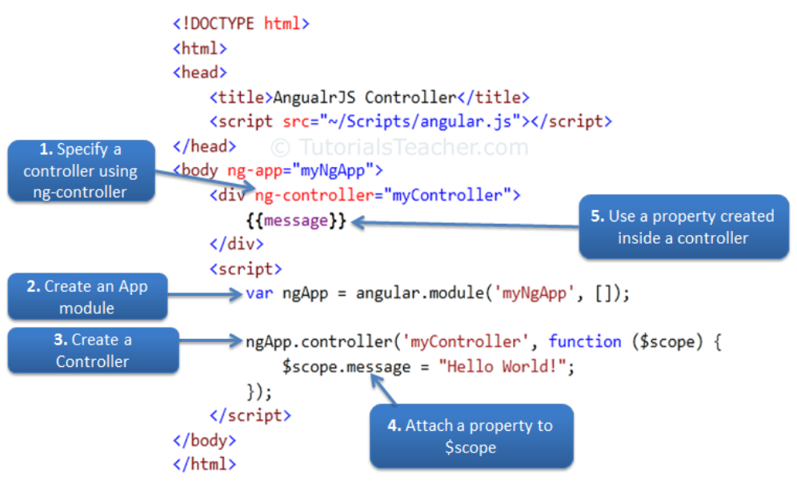
Example

Slide 39
Attach Behaviors
You can attach multiple methods to the scope object inside a controller, which can be used as an event handler or for other purposes.
Example:
Handle Button Click
Note that the properties and methods attached to the scope object inside a particular controller is only available to the HTML elements and its child elements where ng-controller directive is applied.

Slide 40
Attach Complex object
You can also attach an object to the $scope inside controller and display value of its properties in HTML.
Example: Attach an object
A student object is attached to the $scope and its properties and methods can be accessed using an expression, ng-model, or ng-bind directives with dot notation.

Slide 41
Nested Controllers
Angular allows nested controllers.
Example
a child controller can access properties and methods attached in parent controller function, whereas parent controller cannot access properties and methods attached in child controller.

Slide 42
Controller Methods
Controllers In External Files
In larger applications, it is common to store controllers in external files.
Just copy the code between the <script> tags into an external file named personController.js:

Slide 43
AngularJS Modules
An AngularJS module defines an application.
The module is a container for the different parts of an application.
The module is a container for the application controllers.
Controllers always belong to a module.
A module in AngularJS is a container of the different parts of an application such as controller, service, filters, directives etc. It supports separation of concern using modules.

Slide 44
Creating a Module
A module is created by using the AngularJS function angular.module
<div ng-app="myApp">...</div>
<script>
var app = angular.module("myApp", []);
</script>
The "myApp" parameter refers to an HTML element in which the application will run.

Slide 45
Application Module
An AngularJS application must create a top level application module.
This application module can contain other modules, controllers, filters, etc.

Slide 46
Example: Create Application Module
<!DOCTYPE html>
<html>
<head>
<script src="~/Scripts/angular.js"></script>
</head>
<body ng-app="myApp"> @* HTML content *@
<script>
var myApp = angular.module('myApp', []);
</script>
</body>
</html>

Slide 47
Example Explanation
The angular.module() method creates an application module, where the first parameter is a module name which is same as specified by ng-app directive.
The second parameter is an array of other dependent modules [].
In the above example we are passing an empty array because there is no dependency.
Note:
The angular.module() method returns specified module object if no dependency is specified.
Therefore, specify an empty array even if the current module is not dependent on other module.

Slide 48
Example:Create Controller Module
In the above example, we have created a controller named "myController" using myApp.controller() method.
Here, myApp is an object of a module, and controller() method creates a controller inside "myApp" module.
So, "myController" will not become a global function.

Slide 49
Modules in Separate Files

Slide 50

AngularJS Filters
AngularJS Filters allow us to format the data to display on UI without changing original format.
Filters can be used with an expression or directives using pipe | sign.
Angular includes various filters to format data of different data types. The following table lists important filters.

Slide 51
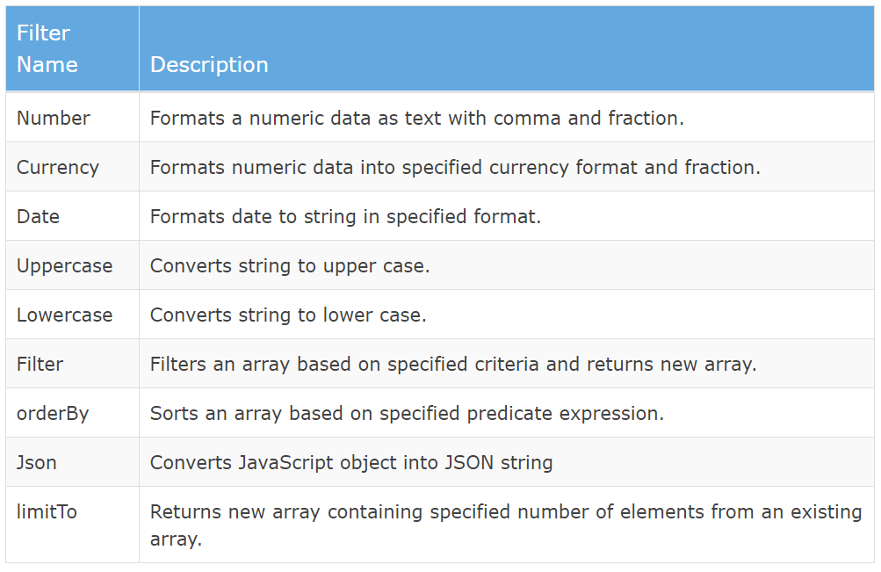

Slide 52

Number Filter
A number filter formats numeric data as text with comma and specified fraction size.
If a specified expression does not return a valid number then number filter displays an empty string.
The example demonstrates how to use number filter with number expression or a model property.

Slide 53
Currency Filter
The currency filter formats a number value as a currency.
When no currency symbol is provided, default symbol for current locale is used.
Example:
In the above example, we have applied currency filter to person.salary, which is a numeric property. It can be displayed with different currency symbols and fractions.

Slide 54

Date filter
Formats date to string based on the specified format.
Uppercase/lowercase filter
The uppercase filter converts the string to upper case and lowercase filter converts the string to lower case.

Slide 55

Filter
Filter selects items from an array based on the specified criteria and returns a new array.
orderBy filter
The orderBy filter sorts an array based on specified expression predicate.

Slide 56
Adding Filters to Expressions
Filters can be added to expressions by using the pipe character |, followed by a filter.

Slide 57
Adding Filters to Directives
Filters are added to directives, like ng-repeat, by using the pipe character |, followed by a filter:
The currency Filter
The currency filter formats a number as currency:
By default, the locale currency format is used.
Syntax
{{ number | currency : symbol : fractionsize }}

Slide 58
AngularJS Services
In AngularJS you can make your own service, or use one of the many built-in services.
In AngularJS, a service is a function, or object, that is available for, and limited to, your AngularJS application.
AngularJS has about 30 built-in services. One of them is the $location service.
The $location service has methods which return information about the location of the current web page:
Note that the $location service is passed in to the controller as an argument. In order to use the service in the controller, it must be defined as a dependency.

Slide 59
Why use Services?
For many services, like the $location service, it seems like you could use objects that are already in the DOM, like the window.location object, and you could, but it would have some limitations, at least for your AngularJS application.
AngularJS constantly supervises your application, and for it to handle changes and events properly, AngularJS prefers that you use the $location service instead of the window.location object.

Slide 60
The $http Service
The $http service is one of the most common used services in AngularJS applications. The service makes a request to the server, and lets your application handle the response.

Slide 61
The $timeout Service
The $timeout service is AngularJS' version of the window .setTimeout function.
The $interval Service
The $interval service is AngularJS' version of the window.setInterval function.

Slide 62
Create Your Own Service
To create your own service, connect your service to the module:
Use a Custom Service Inside a Filter
Once you have created a service, and connected it to your application, you can use the service in any controller, directive, filter, or even inside other services.
To use the service inside a filter, add it as a dependency when defining the filter:

Slide 63
MVC
AngularJS is a framework of JavaScript which work on MVC model. MVC stand for Model View Controller. Model View Controller is a software design pattern for developing web application. It given software application into three interconnected parts; Model, View and Controller.
Dependency Injection
AngularJS has a built-in dependency injection subsystem that helps the developer by making the application easier to develop, understand, and test.
Validation
AngularJS provides client side validation same like JavaScript. Using AngularJS you can create your own validation.

Slide 64
Filter
Filter are mainly used for modify the data. Filters can be added to expressions and directives using a pipe (|) character.
Directives
A directive is something that introduces new syntax. It improve the feature or functionality of html elements. Directives are markers on a DOM element which attach a special behavior to it. For example, static HTML does not know how to create and display a date picker widget. To teach HTML this new syntax we need a directive. AngularJS directives are extended HTML attributes with the prefix ng-.
Forms
An AngularJS form is a collection of input controls like button, input elements. AngularJS has some features for binding data of HTML form input fields to the model object ($scope). You bind an input field to a model property using the ng-model directive.

Slide 65
Advantage of AngularJS
Dependency Injection: Dependency Injection specifies a design pattern in which components are given their dependencies instead of hard coding them within the component.
Two way data binding: AngularJS creates a two way data-binding between the select element and the orderProp model. orderProp is then used as the input for the orderBy filter.
Testing: Angular JS is designed in a way that we can test right from the start. So, it is very easy to test any of its components through unit testing and end-to-end testing.
Model View Controller: In Angular JS, it is very easy to develop application in a clean MVC way. You just have to split your application code into MVC components i.e. Model, View and the Controller.
Directives, filters, modules, routes etc.

Slide 66
Features of Angularjs
It gives rich Developer control.
It provides reusable components.
It provides capability to create Single Page Application in a very clean and maintainable way.
It provides data binding capability to HTML thus giving user a rich and responsive experience.
With AngularJS, developer write less code and get more functionality.
In AngularJS, views are pure html pages, and controllers written in JavaScript do the business processing.

Slide 67
Advantage of Angularjs
AngularJS is a framework of JavaScript. It improve the properties of Html elements. Some advantage of of angularjs are;
Less Code: It help to write less code. Using angularjs developers can achieve more functionality with writing less code.
Testable: It make your application testable. AngularJS code is unit testable.
It increase the level of abstraction.
It provides reusable components.
Using this you can design more responsive web pages.
It work well with other Libraries.
It help to make and design a big applications.
AngularJS support most of all new web browser and all mobiles OS.
In AngularJS view are pure html code and controller are written in JavaScript to achieve business logic.

Slide 68
Dis-advantage of Angularjs
Not Secure: It is a framework of JavaScript not a server side programming. Only server side programs provides security, server side authentication and authorization provides security for application.
Depends on User: If any user disable JavaScript in their own browser then nothing will be apply on your application related to JavaScript and AngularJS, Only basic Html page will display.

Slide 69
AngularJS Data Binding
Data binding is a very useful and powerful feature used in software development technologies.
It acts as a bridge between the view and business logic of the application.
AngularJS follows Two-Way data binding model.

Slide 70
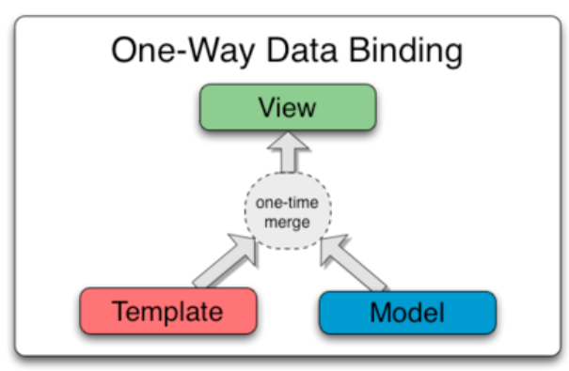
One-Way Data Binding
The one-way data binding is an approach where a value is taken from the data model and inserted into an HTML element.
There is no way to update model from view.
It is used in classical template systems.
These systems bind data in only one direction.

Slide 71
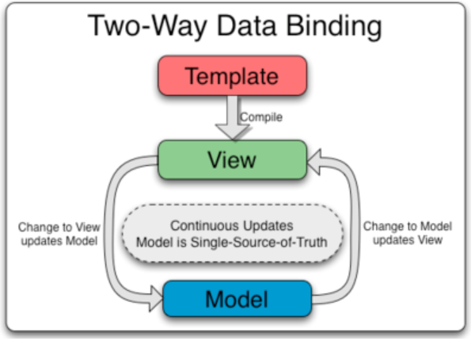
Two-Way Data Binding
Data-binding in Angular apps is the automatic synchronization of data between the model and view components.
Data binding lets you treat the model as the single-source-of-truth in your application.
The view is a projection of the model at all times.
If the model is changed, the view reflects the change and vice versa.

